Slide 1

Devin AI Usage & Cost Optimization
A Comprehensive Technical Guide to Metering Drivers, ACU Consumption Variables, Sleep Behavior Mechanics, and Administrative Guardrails.
Metering Drivers
Zero-Cost Sleep
Task Scoping
Cost Controls

Slide 2




How Devin Metering Works
Agent Operations & Reasoning
Environment & OS Architecture
Tooling & Workstream Scale
Cognitive Loops: Planning, step-by-step reasoning, and decision-making cycles.
OS Overhead: Windows VMs use ~9% more ACUs than Linux (Ubuntu) due to system overhead.
Test Execution: Running automated test suites, compilers, and Docker container builds.
Code Execution: File modifications, AST edits, terminal execution, and linter runs.
Repo Indexing: Cross-repository symbol searches and DeepWiki indexing routines.
Browser Workloads: Headless Chromium interaction, page navigation, and visual UI testing.
Context Window: Processing expansive prompt loops, repository indexes, and file trees.
Parallel Agents: Spawning Managed Devins allocates child VMs, scaling ACU burn concurrently.
Active Compute: Reserved CPU, RAM, and network throughput during live agent runs.

Slide 3





Sleep & Idle Protections
Zero-Cost Sleep State
0.1 ACU Auto-Sleep Threshold
Non-Metered Idle Waits
When a session completes its current task or goes idle, Devin enters Sleep mode.
Devin automatically enters Sleep state after roughly 0.1 ACUs of inactivity.
Usage metering is automatically paused during inactive waiting periods:
While sleeping, the session consumes zero ACUs or quota credits. You can wake the agent anytime with a new message without losing session state.
This automated guardrail ensures that awake-but-idle time adds up to negligible cost, protecting your budget from runaway idle charges.
Devin does not consume usage while waiting for human user input/approvals, waiting for long external test suites, or during repo setup/cloning phases.

Slide 4
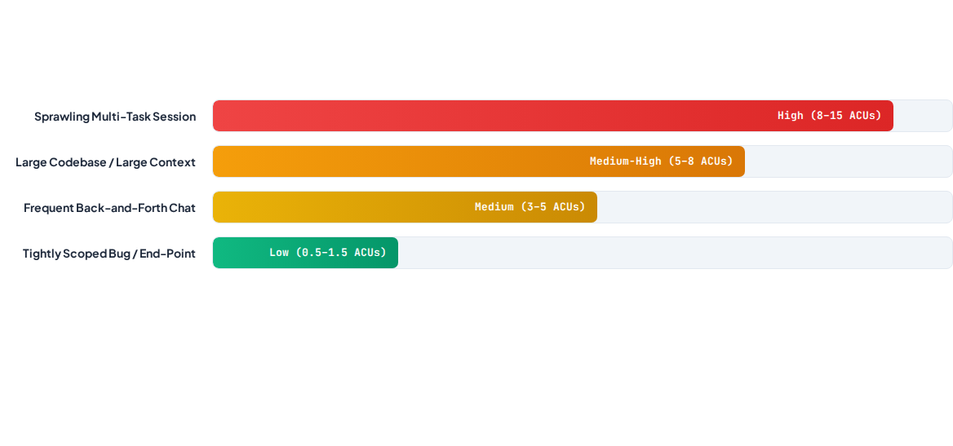
ACU Consumption Variables

Slide 5


Task Scoping & Prompt Optimization
Delegate Bounded Tasks: Define clear end goals, expected deliverables, and verification criteria upfront rather than vague open-ended requests.
Split Big Projects: Break massive epics into smaller sub-tasks across separate sessions to leverage unlimited parallel execution cleanly.
Minimize Back-and-Forth: Provide comprehensive context in the initial prompt to reduce iterative correction loops and context inflation.
Keep Sessions Short: Aim for tasks under 90 minutes of equivalent human engineering effort for maximum reliability and lowest ACU burn.

Slide 6


Memory & Administrative Controls
Memory & Context Optimization
Administrative Cost Guardrails
Pinned Knowledge Items: Pin Knowledge to specific repos to prevent context token inflation across unrelated tasks.
Auto-Review Trigger Modes: Set Devin Review to run manual-only or on draft-ready PRs to avoid review spend on every commit.
Lean AGENTS.md Rules: Keep rule files concise and focused on lint/test execution rather than verbose documentation.
Session Spending Limits: Configure default max credit/ACU caps per session from Settings > Usage.
Executable Skills: Use SKILL.md procedures so Devin follows established paths without trial-and-error exploration.
Auto-Reload Thresholds: Set strict cap thresholds for prepaid on-demand credit refills.

Slide 7

Image Sources
https://static.vecteezy.com/system/resources/thumbnails/065/479/753/small_2x/high-tech-ai-interface-with-circular-digital-hud-elements-futuristic-dashboard-graphics-and-geometric-tech-icons-on-a-light-blue-abstract-background-free-vector.jpg
Source: www.vecteezy.com

